Slide 1
Human Resource Analytics
ITCS 6112
Term Project
SCRUM DEVELOPERS
Manasa Sadananda
Rakesh Harish
Aishwarya Gunasekar
Stephen Stroud
Christopher Dong

Slide 2
Outline
Project Description
Dataset Description
Data Analysis
Front-end Design
Results
Closing Remarks

Slide 3
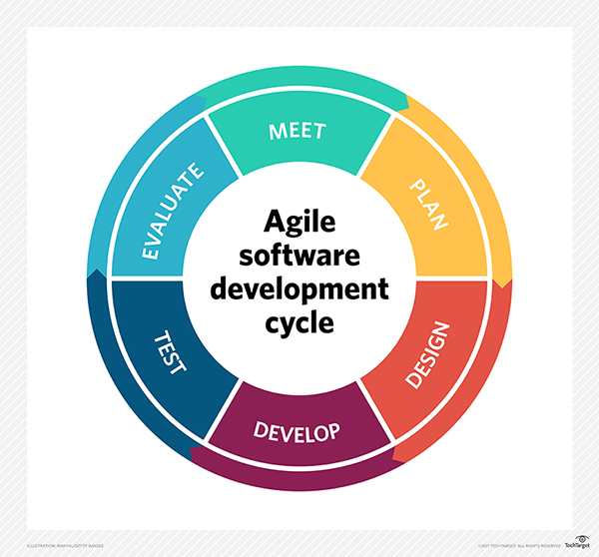
PROJECT DESCRIPTION
The Age of Data Proliferation
Emergence on Data Science
Efficient tracking on 500+ employees
Retaining and recruiting talents
Predictive analytics within employment
Employed Agile methodology (Scrum)
Total Sprints - 5

Slide 4
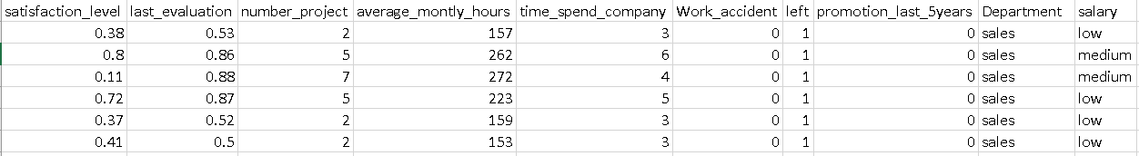
Dataset description
Sourced from Kaggle
Consists of 15500 observations with no missing or garbage values
Consists of Numeric and Categorical values

Slide 5
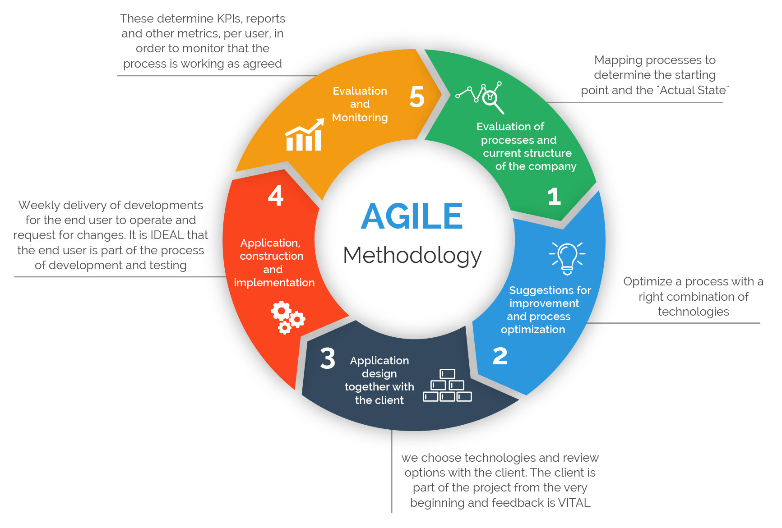
Agile Methodology

Slide 6
Data Analysis
Exploratory Data Analysis/Preprocessing
Data Modelling
Decision Tree
K Nearest Neighbor
Neural Networks
ADA Boost
Prediction Tool

Slide 7
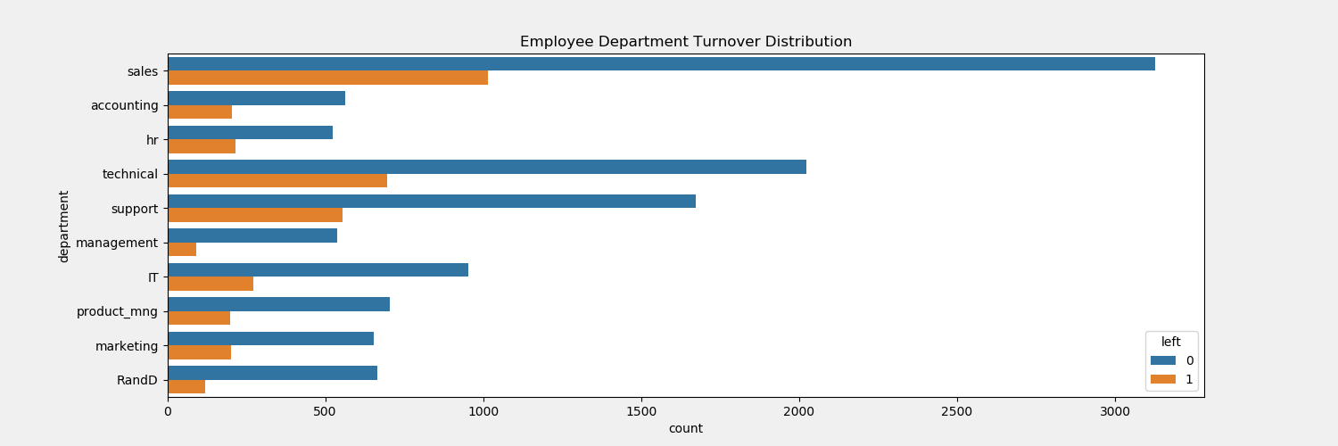
Exploratory Data Analysis

Slide 8
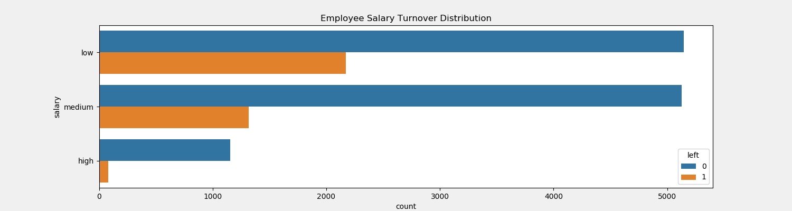
Exploratory Data Analysis (Contd.)

Slide 9
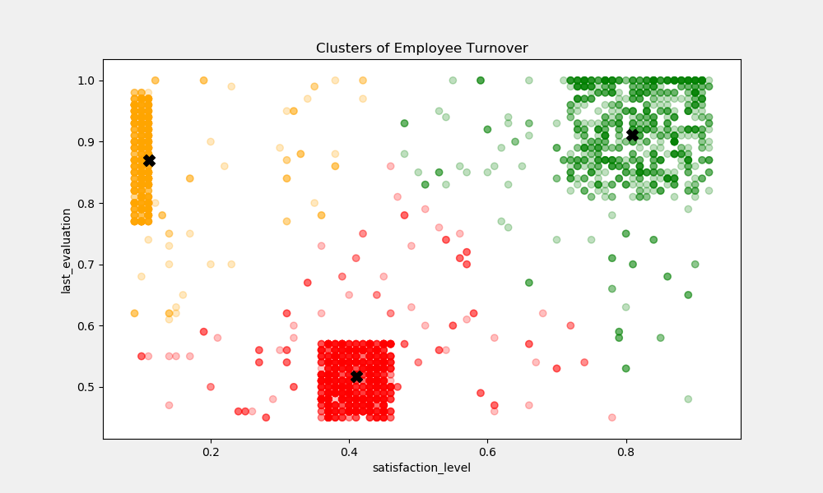
Exploratory Data Analysis (Contd.)

Slide 10
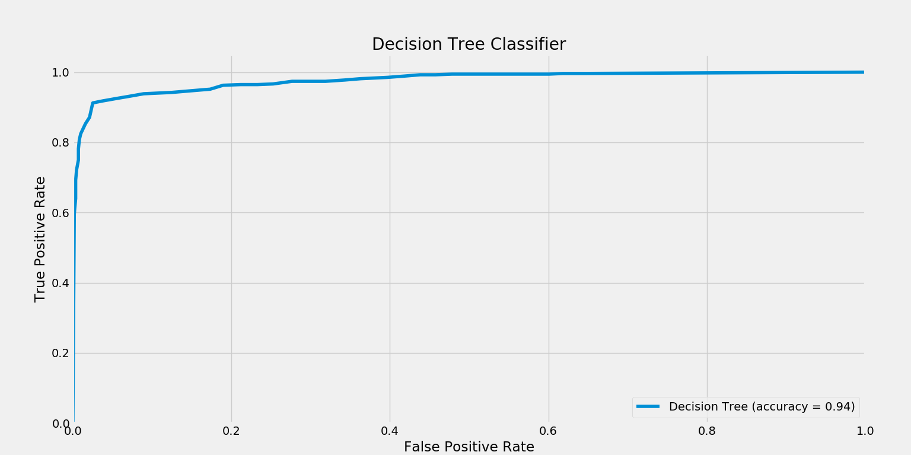
Data modelling
Decision Tree
Accuracy = 94%

Slide 11
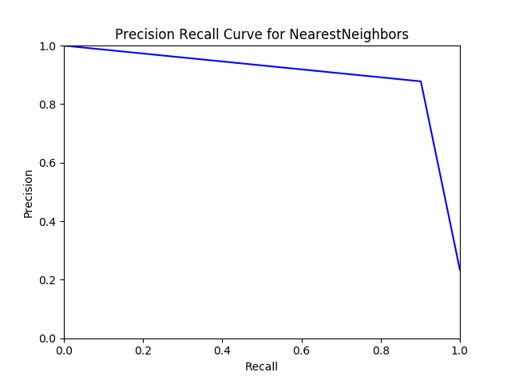
Data modelling (contd.)
K Nearest Neighbors
Accuracy = 94.5%

Slide 12
Data modelling (contd.)
Neural Networks
Accuracy = 95.8%

Slide 13
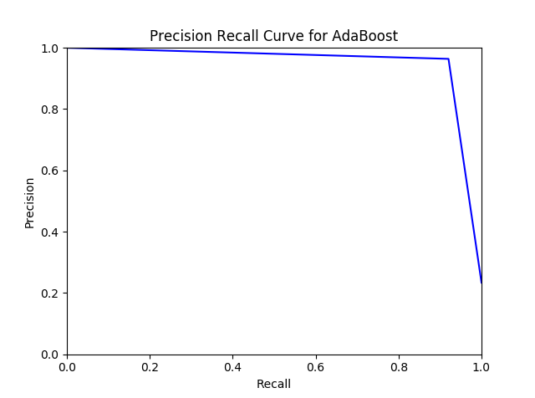
Data modelling (contd.)
ADA Boost
Accuracy = 97.3%

Slide 14
Data modelling (contd.)

Slide 15
Project Demo

Slide 16


Slide 17
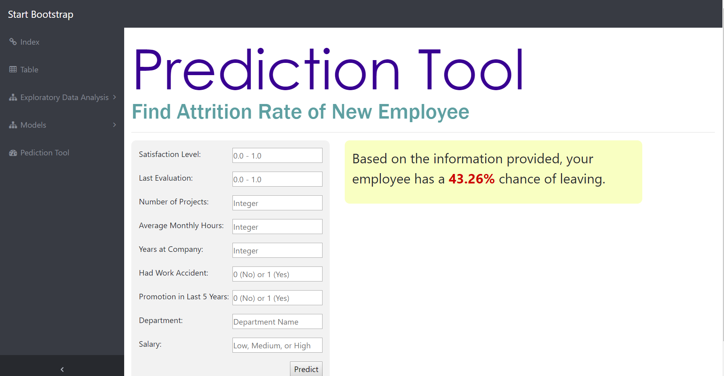

Slide 18
Thank you!

